Slide 1
Intelligent Driving System
PowerGrid Engineering, LLC
Progress Energy Inc.
Group 3
Celina Martin
James Kies
Mike Jones
Yazen Ghannam

Slide 2
Goals
High Efficiency
  Intelligent Control System
Reliable Operation
  Battery Capacity Monitoring
User Friendly Interface
  Touch Screen

Slide 3
Objectives
Intelligent Driving System
  Is designed to be applicable to any size electric vehicle
Reliable Operation
  Battery Capacity Monitoring
    Current sensing
    Voltage sensing
User Friendly Interface
  Touch Screen
    Three modes of operation
      Performance Mode
      Normal Mode
      Economy Mode

Slide 4
Specifications
7” touchscreen with 800 x 600 resolution
Current and Voltage sensors with 0.1A/0.1V linearity, respectfully
120VAC/12VDC converter compatible of 12VDC, 5VDC, 3.3 VDC outputs
12V Solar panel capable of charging one 12VDC battery

Slide 5

Mechanical System
F150 Powerwheels
This model uses two motors to obtain speeds from 0-2.5mph, and 0-5mph

Slide 6
Electrical System
Power Supplies
12VDC Battery
  Deliveries power to all other electronics
Solar Panel
  Charges an Auxiliary Battery
Battery Management System (BMS)
  Sensing varies parameters of the Battery Pack

Slide 7
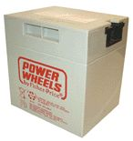
Electrical System
Battery Specifications
Sealed Lead Acid
Voltage: 12VDC
Capacity: 9.5Ah
Length: 5.23in
Width: 4.25in
Height: 5.50in

Slide 8
Electrical System
Solar Power

Slide 9
Electrical System
Battery Management System
Discharge Rate
State of Charge
State of Discharge
Depth of Discharge
Temperature

Slide 10
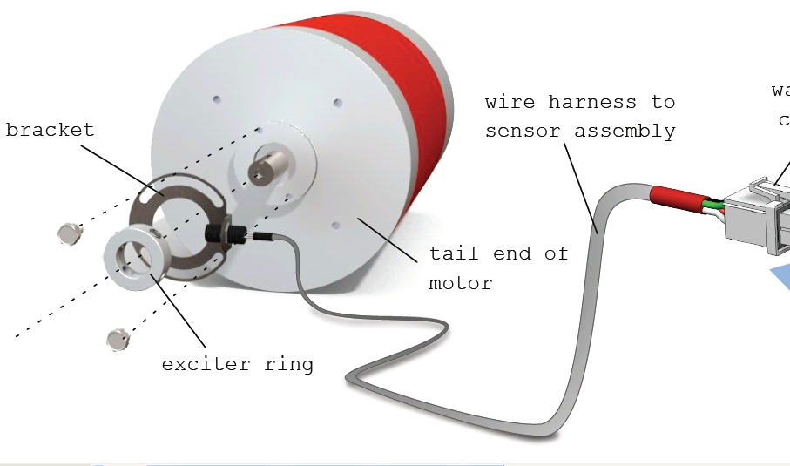
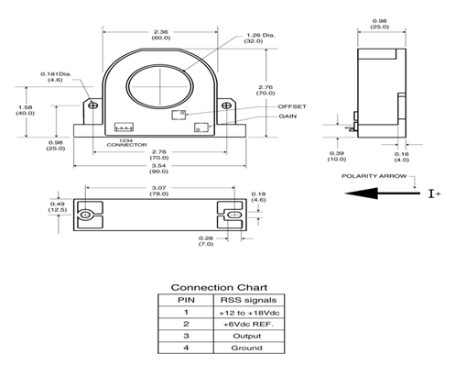
Electrical System
RPM/Motor Current Sensors
Hall effect ring has four symmetrically placed sensors attaches to motor shaft to measure motor rotational speeds.
The RPM will be displayed on the touch screen to allow driver to know when to shift gears because electric vehicles don’t have engine noise to know when to shift.
Current used to measure the +/- 500 amps of motor and battery current is the F.W. Bell RSS-200-A Hall Effect sensor. The sensor has a linearity over the +/-200A range and can also measure current up to +/- 500A with some minor non-linearity effects. The output sensitivity is 8mV/A centered around a 6VDC reference voltage.

Slide 11
Electrical System
Sensor /Motor Controller
Microchip PIC32 Microcontroller
16 Digital temperature sensor inputs
10 Bit A/D
PWM output
Digital Outputs
Digital Inputs
Filters and Voltage conversion
Output DAC
SPI communication Bus
Debug ports
Notes:
Microchip PIC32 Microcontroller will be used to interface between all of the sensors
and provide motor control functions. Power calculation will be completed before passing
to other micro
16 digital temp sensor inputs will be interrupt driven
Ten 10 Bit A/D inputs for voltage and current measurements
1 channel PWM output for controlling motor speed
Multiple digital outputs for controlling fans, solenoids ,etc.
They drive an interface IC that connects to MOSFETS transistors that switch 12 volt power
Digital inputs for motor RPM, Vehicle Speed sensor
Filtering and voltage regulators and convertors 2.5V REF, 3.3, 5 and 6 volt ref
Output DAC for controlling existing purchased motor drive electronics
SPI Bus to communicate with Touch Screen Microcontroller
Debug ports for integration activities

Slide 12
Electrical System
Sensor /Motor Controller
DC Motor Drive
IXYS Low Side Drive
- IXDN414Y
IXYS IGBT transistors
- IXGK320N60B3
Motor Protection Diode
- MURTA60060R
Difference Amplifier
- AD629BRZ
Bulk Capacitance
Current Sensing
- LT1111
- RSS-200-A
Notes:
DC Motor Drive will require PWM switching of 144Vdc at up to 500 amps .
The PWM switching frequency will be around 15Khz. The Drive does not require a full H bridge
Design because the motor only has to rotate in one direction
Low side drive will be accomplished by an IXYS IXDN414Y high current switch.
It is capable of switch large amounts of capacitance at frequencies greater than 200kHz
Utilizes three IXYS IXGK320N60B3 IGBT’s connected in parallel to help distribute
power load. The IGBT’s are 500V at 320A each and can be switched at up to 25Khz
Motor will contain protection diode MURTA60060R across to limit the voltage
rise when IGBT’s are switched off
AD629BRZ Analog device Difference amplifier with High common mode input
range up to 300Vdc for measuring motor voltage
Bulk capacitors will supply located close to motor to supply instantaneous
current during motor switching and low impedance sink for motor EMF because wires
coming from batteries will have some inductance. This should help reduce EMI emissions
Current sensing will be accomplished by using and LT1111 amplifier that measures
the output of the F.W. Bell RSS-200-A Hall Effect sensor

Slide 13
Electrical System
Sensor /Motor Controller
Preliminary Schematic of Sensor/ Motor Controller.
Notes:
Preliminary Schematic of Sensor/ Motor Controller. The circuit card is currently being
Updated to add filters, and new voltage regulators along with additional connectors for debug.

Slide 14
Electrical System
Sensor /Motor Controller PWB & DC Motor Drive Electronic Assembly
Sensor / Motor Controller PWB and DC Motor Drive Assembly
IGBT Heat Sink and Fans
Steady state power dissipation
Aluminum Housing
Power Wires and Terminals
Notes:
Sensor / Motor Controller PWB and DC Motor Drive Assembly will be placed inside an
Aluminum chassis to help shield EMI radiation from affecting other automobile functions.
IGBT Heat Sink and Fans. Because the IGBT’s will be switching over 50kWatts of power
They will be located on fin stock heat sinks with fans blowing across them will be required
to remove the heat.
Steady state power dissipation is estimated at 50 watts. This is assuming that overall steady
state power consumption is around 13Kwatts
Aluminum housing will be mounted to auto frame for heat conduction and EMI grounding purposes
Power Wires and Terminals will consist of 00 gauge wire and terminals capable of handling the current

Slide 15
Electrical System
Potential Issues
Noise
  Additional Filtering
  Impedance Shielded Cable
IGBT Power Dissipation
  500 Amps at 144VDC
  Heat Sinking
Purchased vs. Designed Motor Drive Electronics
Incorporate Voltage Pedal into Motor Drive Electronics with 3 modes of operation
10 bit A/D’s
  Precision of resolution for motor currents
    1 Amp resolution
Notes:
Potential Issues
Noise The Large switching power >50Kwatts required to drive the motor is
anticipated to generate severe noise. The electronics on both circuit card assemblies
will have filtering to try and alleviate some of this noise but until the car is
assembled and operating the amount will have to be measured .
Temperature sensors will require impedance controlled wire with shields to help reduce
EMI pickup
IGBT Power Dissipation-The IGBTs that have to handle up to 500 amps at 144 volts. The
50 watts of power
dissipation will require a good conduction path to the auto structure along with fans to handle
full power operation
Purchased vs. Designed Motor Drive Electronics. Tradeoff between using existing motor drive
electronics that the sponsor has purchased versus using our design will be determined after
the initial testing of the automobile. The most efficient design one will be used.
Incorporate Voltage Pedal into Motor Drive Electronics with 3 modes of operation
If we use existing motor drive electronics then incorporating the voltage pedal and controlling
the 3 modes of operation will be more difficult then using our own design. Will not be able
to determine finalize the design until after initial testing.
10 bit AD’s may not be enough resolution for the large dynamic range
of the motor and battery currents. There range is +/-500amps which results in around
1 Amp resolution. May have to add an 12 bit A/D for better resolution

Slide 16
Electrical System
Temperature Sensors
Options
  Analog
  One wire technology
  Digital
Part Number | Type | Temp. Range | Input Voltage | Output | Cost
LM335 | Analog | -40°C to +100°C | 1.8V to 5.5V | Voltage | $1.35
TMP20 | Analog | -55°C to +130° | 1.8V to 5.5V | Voltage | $0.87
TMP03 | Digital | -40°C to +100°C | 4.5V to 7V | Open Collector | $5.04
TMP04 | Digital | -40°C to +100°C | 4.5V to 7V | CMOS/TTL | --
DS18S20 | 1-Wire | -55°C to +125°C | N/A | Digital 9-bit | $4.00
DS18B20 | 1-Wire | -55°C to +125°C | N/A | Digital 12-bit | $4.00
Notes:
For thermal monitoring several temperature sensors will be placed throughout the vehicle, mainly on the batteries and microcontroller, where most of the heat will be generated. There were three options of temperature sensors consisting of either analog, digital or one wire that we could possibly use. The benefits of analog sensors would be the overall cost required, the one wire sensor would decrease the number of wires strung throughout the vehicle in wiring harness and finally our selection would be the digital sensor which would eliminate the need to MUX the readings and also is an open collector device.

Slide 17
Electrical System
Temperature Sensors
TMP03 Digital Temp Sensor
  Input voltage: 5VDC
  Accuracy of 1.5°C
Interface
  3.3kΩ pull up resistor
TMP03
TMP03
TMP03
TMP High
TMP03
Sensor/Motor Controller
User Interface
Yes
Fan ON
No
LCD Display
Fan OFF
Notes:
The TMP03 digital temperature sensor will have an input voltage of 5VDC and will measure with a 1.5 degree Celsius accuracy. To interface with our sensor/motor microcontroller a 3.3k Ohm pull up resistor will be used. In the block diagram you can see that each battery along with the microcontroller will have a digital temperature sensor fed to the sensor/motor controller which will then be interfaced to the user interface where it can not only be displayed for the user to see on the LCD display but can also be compared for a fan to turn on. Depending upon whether the vehicle is in economy mode or not this turn on point may be altered for a higher temperature range. These values will be continually monitored to turn off the fan once the temperature has decreased to save battery power.

Slide 18
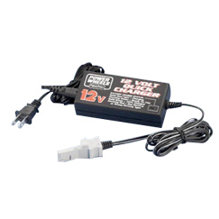
Electrical System
Power Converters
AC/DC Power Converter (Battery Charger)
  Specifications
    Input Voltage: 120VAC
    Output Voltage: 12VDC
    Lead-Acid Compatible
For this we will use the standard Fisher-Price battery charger for this model
Notes:
In order to charge the batteries in the rear of the vehicle a AC/DC Power converter also known as a battery charger will be used. The input voltage is equal to 120VAC, the standard wall outlet voltage, and the output is 144VDC as set by the battery pack and motor selected. This converter must be set for lead-acid charging and is greater than 90% efficient.

Slide 19
Electrical System
Power Converters
AC/DC – DC/DC Power Conversion
Block Diagram
1500W ElCon
Battery Charger
144VDC/8A
Battery Pack
300W HWZ
DC/DC Converter
12VDC/25A
12V Auxiliary Battery
Notes:
Here you can see the overall AC/DC-DC/DC power conversion block diagram where 120VAC is being taken in from the wall outlet and interfacing with the 1500W Elcon battery charger. This charger provides 144VDC at 8 amps to the main battery pack and then connections to the 300W HWZ DC/DC converter. 12VDC at 25 amps is then delivered to the 12V auxiliary battery.

Slide 20
Electrical System
Power Converters
Small DC/DC Power Converters
  12VDC -> 5VDC
    Temperature Sensors
  12VDC -> 3.3VDC
    Microcontroller A/D inputs
Linear Regulator
  High Heat Waste
  Low Efficiency
  Low Cost
Switching Regulator
  Low Heat Waste
  High Efficiency
  Medium Cost
Notes:
A couple of small DC/DC step down power converters were designed for the vehicle. A 12VDC/5VDC buck converter was designed to provide power to all the temperature sensors throughout the vehicle and a 12/3.3 buck converter is used for the microcontroller A/D inputs. We selected to use switching regulators for these in order to decrease heat and improve efficiency at a medium cost increase.

Slide 21
Electrical System
Power Converters
LM2596 Simple Switcher Step Down Power Converter
  +/- 4% tolerance
  150kHz switching frequency
  Additional components (L,C) selected from datasheet
Notes:
The LM2596 Simple switcher step down power converter was selected for its 4% tolerance and 150kHz switching frequency. The additional inductor and capacitor components were selected using the provided datasheet

Slide 22
Computer System
Motor Control
Microchip PIC32
  Economy Mode
    Independent of user
  C Code
Possible Issues
  Determining the Mode Specifications
Notes:
Will process efficiency data and set “Economy Mode” as needed independent of user input

Slide 23
Computer System
User Interface Hardware
Planar PT1545R 15” Touchscreen LCD Monitor
  Large enough to display all required information
  Serial/USB interface
  Internal Power Supply
  Internal Speakers
  Open Source Drivers, if needed
  Cost ~$420
  Fully integrated solution
    No need to match touchscreen to monitor
    No need to supply touchscreen interface on motherboard
    Costs about the same as a non-integrated solution
Possible Issues
  Contrast Ratio/Brightness may be an issue in bright outdoor lighting
  Glare (includes Anti-Glare coating but this was probably not designed to be used in an outdoor setting)

Slide 24
Computer System
User Interface Hardware
BeagleBoard-xM
  TI OMAP3530 ARM Cortex-A8 processor
  HD video capable DSP core
  128MB DDR RAM; 256MB Flash Memory
  I²C, SPI protocols
  DVI-D, USB, RS-232, Stereo Out
  Includes components needed to power user interface and connect to peripherals
  Costs about the same as a custom made solution (~$150) without the hassle of designing and soldering components together
  Community driven project with plenty of support

Slide 25
Computer System
User Interface Software
Operating System
  Android 2.3
  Open Source and freely available
  Natively supports touchscreen interfaces
  Includes a large widget library
Possible Issues
  Touchscreen Drivers are not designed for Android
    Linux Drivers are available so it’s possible to port them to Android
  Slow booting
    Remove non-critical components like Bluetooth, 3G, internet, etc.

Slide 26
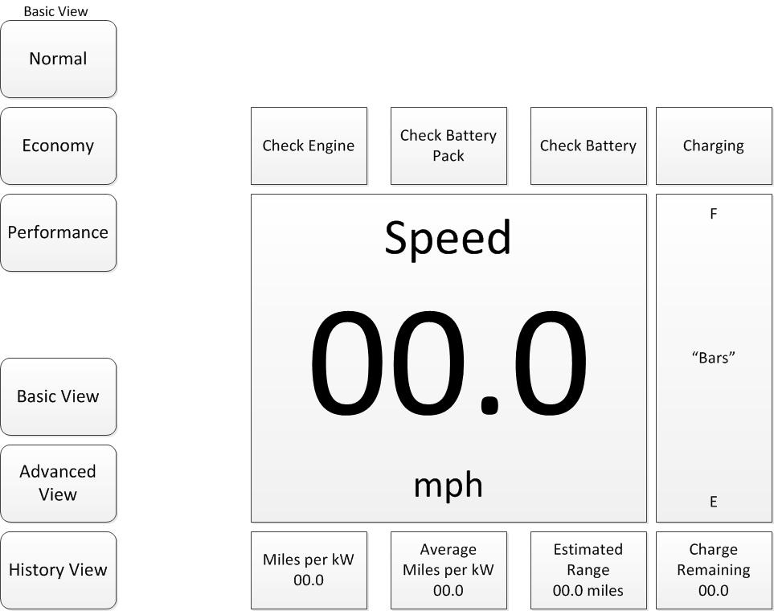
Computer System
User Interface Basic View
    Provides basic information, such as engine status, speed, “fuel”, etc.

Slide 27
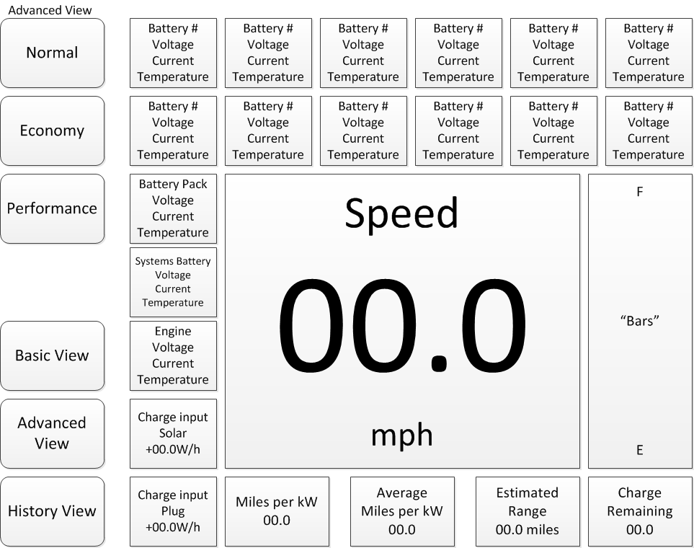
Computer System
User Interface Advanced View (Optional)
    Includes everything from Basic View but adds more sensor information from batteries and engine

Slide 28
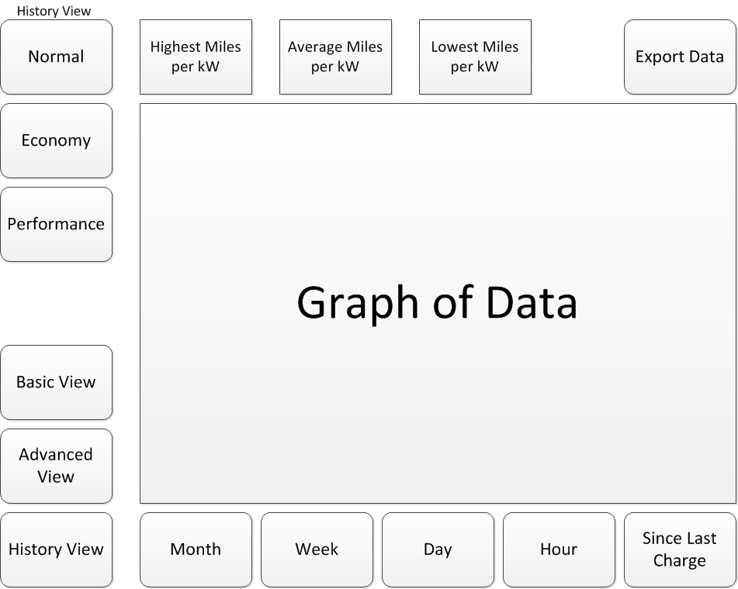
Computer System
User Interface Historical View (Optional)
    Displays efficiency history in graph form and notes the minimum and maximum

Slide 29
Project Budget
Trottle Pedal Assembly | $160.00
Electric Motor | $1,875.00
Motor Controller | $2,050.00
75Ah Sealed Lead Acid | $1,624.35
Temperature Sensor | $100.80
Different Amplifier | $55.28
Current Transformer | $116.34
AC/DC Converter | $340.00
144/12 DC Converter | $125.00
Regulator Simple Swt | $5.18
SMT power inductor-68uH | $0.00
Capacitor 220uF | $5.00
Diode-Schottky | $1.48
Capacitor 330uF | $1.12
Solar Charger | $185.00
DC Contactor | $169.00
ESTOP | $24.06
Solar controller | $34.95
Roof Base Rack | $243.52
Grand Total | $7,116.08
Notes:
Here is the overall bill of materials for the car conversion with a total budget of 7,116 dollars.

Slide 30
Project Status
Notes:
Our current project status is at 95% research, 75% design, 10% prototype and 5% testing.

Slide 31
Immediate Actions
Temperature Sensor/Controller Communication Interface Testing
Design Mounting for Solar Panel
Small DC/DC Load Bank and Efficiency Testing
Finish User Interface Demo

